Slide 1
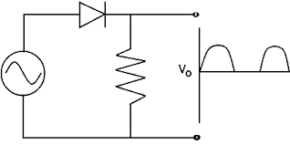
Clipping Circuit or Limiter
It is a wave shaping circuit that takes an input waveform and clips or cuts off its top half, bottom half or both halves together to produce an output waveform that resembles a flattened version of the input.
For example, the half-wave rectifier is a clipper circuit, since all voltages below zero are eliminated.
Half wave rectifier

Slide 2
Diode Clipping Circuits
A clipping circuit that requires only a minimum of two componets ie . a resistor and a diode
Sometimes dc battery is used to fix the clipping level.
Diode acts as a closed switch when forward biased and as an open switch when reverse biased.

Slide 3
Classification of clippers
According to configuration of diodes
Shunt/parallel clippers - diode is conneccted parallel to load
Series clippers - diode conneccted in series to load
b) According to biasing
Unbiased clipper - no dc source/battery
Biased clipper - dc source is used

Slide 4
According to level of clipping
Positive clipper
Negative clipper
Biased clipper
Combination clipper

Slide 5
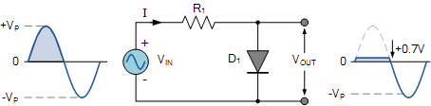
Shunt clippers or Parallel clippers
(1) Positive clipper clipping at 0V
During the positive half cycle of the input wave, the diode is forward biased when the input voltage exceeds +0.7 volts and +0.7V is developed across it.
During the negative half cycle, the diode is reverse biased and the voltage is developed across it.

Slide 6
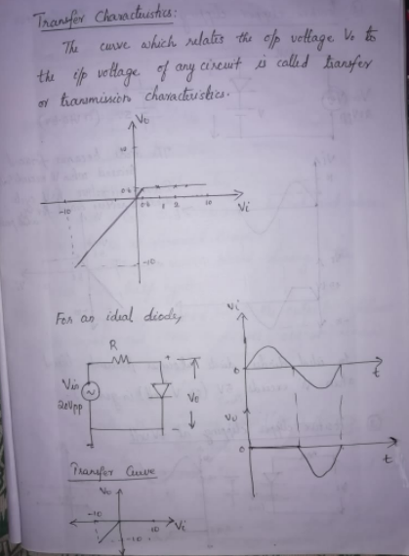
Tranfer characteristics

Slide 7
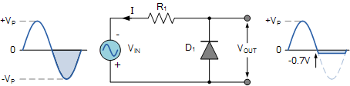
Negative clipper clipping at 0V
During the positive half cycle, the diode is reverse biased and the voltage is developed across it.
During the negative half cycle of the input wave, the diode is forward biased when the input voltage exceeds -0.7 volts and -0.7V is developed across it.

Slide 8
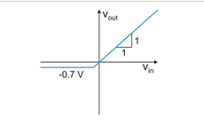

Slide 9
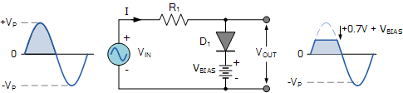
(2) Positive clipper clipping at +V volts
A voltage of V_{BIAS} is connected in series with the diode so that diode is in reverse biased condition when input is 0.
During the +ve half cycle of the input wave, diode remains in reverse biased condition until V_{IN} = V_{BIAS} +0.7V. When V_{IN} > V_{BIAS} +0.7V, the diode becomes forward biased and conducts.
During the negative half cycle, the diode remains in reverse biased condition and the voltage is developed across it.

Slide 10

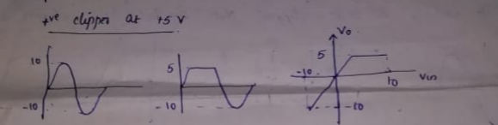

Slide 11
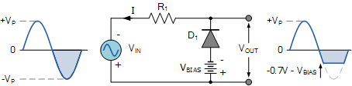
Negative clipper clipping at -V volts (Biased -ve clipper)
A voltage of -V_{BIAS} is connected in series with the diode so that diode is in reverse biased condition when input is 0.
During the positive half cycle, the diode remains in reverse biased condition and the voltage is developed across it.
During the -ve half cycle of the input wave, diode remains in reverse biased condition until V_{IN} exceeds -V_{BIAS} -0.7 . When V_{IN} > -V_{BIAS} -0.7 the diode becomes forward biased and conducts.

Slide 12
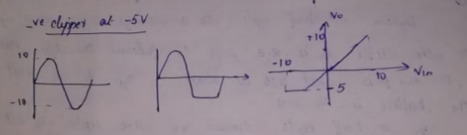

Slide 13
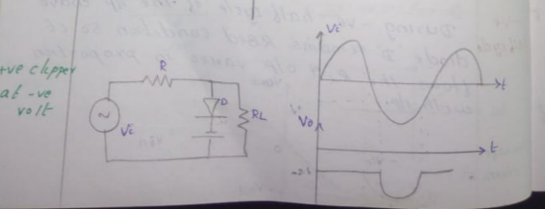
Positive clipper clipping at -V volts (Biased +ve clipper)
During the +ve half cycle of the input wave, diode is forward biased so it act as a short(ie. +ve part is clipped) and voltage across the battery -5V appears at the output.
During –ve half cycle, the diode will be forward biased till -5V and reverse biased after -5 and the entire voltage developed across R_{L}
When the voltage again reaches -5v, diode is FB and it act as short and then output becomes -5v.
Notes:
er

Slide 14

Tansfer characteristics

Slide 15

Negative clipper clipping at +V volts
During +ve half cycle, the diode will be forward biased till +5V and upto that point the output will be at +5v
When the input voltage exceeds +5v, the diode becomes reverse biased and the input voltage will be dropped across the diode or R_{L}
The diode will be in the reverse biased condition untill the inmput becomes less the battery +5v
During the -ve half cycle of the input wave, diode is forward biased so it act as a short(ie. +ve part is clipped) and voltage across the battery +5V appears at the output.

Slide 16
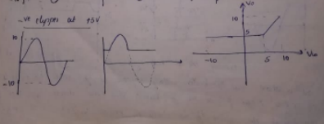
Tansfer characteristics

Slide 17
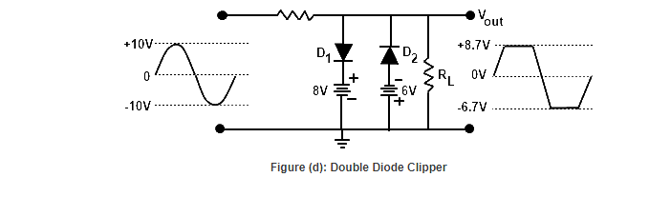
Combinational clipper
When a portion of both +ve and –ve of each hahalf cycle of the input voltage is to be clipped, then combination clipper is used.
During +ve half cyle D2 is always RB. But upto 8v the diode D1 is RB and output follows the input. Above 8v, D1 is FB and act as short. So output is the volt across the battery.
During -ve half cyle D1 is always RB. But upto -6v the diode D2 is RB and output follows the input. Above -6v, D2 is FB and act as short. So output is the volt across the battery.

Slide 18
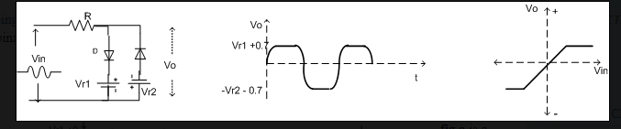
Tansfer characteristics

